Slide 1
MINI-PROJECT-REVIEW
On
LUNG DISEASE CLASSIFICATION USING DEEP LEARNING
AFRA JABEEN- 4AD22CI001
AMRUTA SALAGARE-4AD22CI003
REEM K-4AD22CI042
ANUSHREE HM-4AD23CI401
Under the guidance of
Dr. Anil Kumar C J
Associate Professor and Head
Dept. of CSE-AI & ML
ATMECE, Mysuru

Slide 2
Contents ​
Introduction(Existing System, Problem Statement, Proposed System)​
Literature Survey( IEEE/Springer from 2021-2024)​
System Specification/Requirements​
System Methodology, Implementation-Flow Diagrams
Results, comparative study-snapshots​
Conclusion​
Future Scope​
References( IEEE/Springer from 2021-2024) in IEEE format​

Slide 3
INTRODUCTION
Lung diseases, including pneumonia, tuberculosis, and COVID-19, represent significant global health concerns, with millions of cases reported annually.
Chest X-rays (CXR) are among the most widely used imaging techniques for diagnosing these respiratory conditions.
Recent advances in deep learning, especially convolutional neural networks (CNNs), have revolutionized medical imaging by enabling automatic and accurate classification of various lung conditions.

Slide 4
EXISTING SYSTEM
Transfer Learning Models: VGG-16, ResNet-50, and InceptionV3 are effective for lung disease classification, especially in feature extraction from chest X-rays.
VGG19 + CNN Hybrid: Combining VGG19 with extra CNN layers has achieved good accuracy for multi-class lung disease classification.

Slide 5
PROBLEM STATEMENT
Limitations of Traditional Methods: Manual chest X-ray analysis is time-intensive, error-prone, and yields high false-negative rates.
Need for Early Detection: Timely diagnosis of infectious diseases is critical, but existing systems lack efficiency for large datasets.
Challenges in Current Models: Most models target single diseases, reducing real-world applicability in multi-condition scenarios.
Research Objective: Develop a robust deep learning model for accurate multi-class classification of pneumonia, tuberculosis, COVID-19, and normal lungs, ensuring generalizability across datasets for clinical use.

Slide 6
PROPOSED SYSTEM
Collect and preprocess chest X-ray images from diverse datasets. Apply data augmentation and resize images for consistency.
Use pretrained models for initial feature extraction. Fine-tune these models on lung disease datasets to capture relevant patterns.
Integrate VGG19 with additional CNN layers for enhanced multi-class classification. Train the hybrid model for distinguishing between pneumonia, tuberculosis, COVID-19, and normal lungs.
Test the model on unseen data to ensure robustness. Use performance metrics like accuracy to validate model efficiency.

Slide 7
LITERATURE SURVEY
Alshmrani, G.M.M., Ni, Q., Jiang, R., Pervaiz, H., & elshennawy, N.M. (2024). A Deep Learning Architecture for Multi-Class Lung Diseases Classification Using Chest X-Ray (CXR) Images. Elsevier.
Methodology & Result: The paper proposes a deep learning model for lung disease classification. It classifies pneumonia, lung cancer, TB, lung opacity, and COVID-19. The model uses VGG19 and CNN for feature extraction. Achieved 96.48% accuracy. The model enhances quick and efficient patient diagnosis.
Research Gap: The dataset has uneven class distribution, which might affect model performance, especially for underrepresented diseases.

Slide 8
Yadav, S.S., & Jadhav, S.S. (2019). Deep Convolutional Neural Network-Based Medical Image Classification for Disease Diagnosis. Springer.
Methodology & Result : Medical image classification is crucial for clinical treatment. Traditional methods struggle with performance and feature extraction. The study focuses on pneumonia classification in chest X-rays. techniques evaluated: transfer learning. Data augmentation improves performance across all methods. Transfer learning outperforms other techniques using small datasets.
Research Gap: There is limited exploration of feature enhancement techniques. The paper also notes a lack of optimized transfer learning approaches for small, specialized datasets.

Slide 9
Shivanshu, Riya Bisht, Guru Prasad M.S., & Kanak Mittal (2023). Evaluation of CNN Models for Accurate Classification of COVID-19, Pneumonia, Tuberculosis in Chest X-ray Images.IEEE Conference Proceedings, 25-27 August 2023. Added to IEEE Xplore on 10 October 2023.
Methodology & Result :Utilized two datasets with 2884 chest X-ray images for disease classification, including COVID-19, pneumonia, tuberculosis, and normal cases .
- Applied data preprocessing techniques and trained deep learning models like Custom CNN, VGG16, ResNet50, and DenseNet121 .Achieved a testing accuracy of 87.50% with the Custom CNN model .
- ResNet50 model demonstrated high training accuracy of 94.89% and testing accuracy of 95.31%, showing consistent performance across different datasets .
Research Gap: There is no assessment of the model's robustness when handling low-quality or noisy X-ray images, which are common in real-world scenarios.

Slide 10
Ojasvi Yadav, Kalpdrum Passi, & Chakresh Kumar Jain (2018). Using Deep Learning to Classify X-ray Images of Potential Tuberculosis Patients. IEEE Conference Proceedings, 03-06 December 2018. Added to IEEE Xplore on 24 January 2019.
Methodology & Result :Deep Learning classifies X-ray images for Tuberculosis detection. Achieved 94.89% accuracy using data augmentation techniques. Coarse-to-fine knowledge transfer improved model performance significantly. Multiple techniques combined yield high accuracy in medical data classification. Model trained on specific datasets may limit generalization.
Research Gap: A significant gap identified in the study is the model's limited generalizability. Additionally, the challenge of low region of interest in medical images, which can be as low as 1%, complicates effective classification .

Slide 11
Kavitha S., R.S. Shuapreyaa, P. Prakash, Vaibhav S., Viswa V., & Yogavarshan S. (2024). Classification of Lung Diseases Using Transfer Learning with Chest X-Ray Images. IEEE Conference Proceedings, 22-23 February 2024. Added to IEEE Xplore on 18 April 2024.
Methodology & Result :The paper focuses on lung disease classification using chest X-rays. It employs deep learning models for accurate diagnosis.The NIH dataset contains 112,120 annotated chest X-ray images.ResNet50 achieved the highest accuracy at 83.57%.The study addresses data imbalance using weighted loss techniques. It aims to enhance computer-aided diagnosis tools for medical professionals.
Research Gap: The study uses a large dataset but lacks data augmentation techniques, limiting the model's robustness and generalization across varied imaging conditions and anatomical differences.

Slide 12
SYSTEM REQUIREMENTS
Hardware Requirements:
Processor: Minimum Intel i5 or higher
RAM: At least 8 GB (recommended: 16 GB or more for deep learning).
GPU: NVIDIA GPU with CUDA support (e.g., GTX 1060 or higher; recommended: RTX 3060/3080).
Storage: Minimum 256 GB SSD (recommended: 512 GB or more for faster data access).
Software Requirements:
Operating System: Windows 10/11, Ubuntu 20.04 or higher.
Programming Environment: Python 3.7+ with libraries such as TensorFlow, Keras, and NumPy.
IDE/Tools: VS Code, or collabs.
Other Tools: Anaconda for environment management, CUDA toolkit for GPU acceleration.

Slide 13
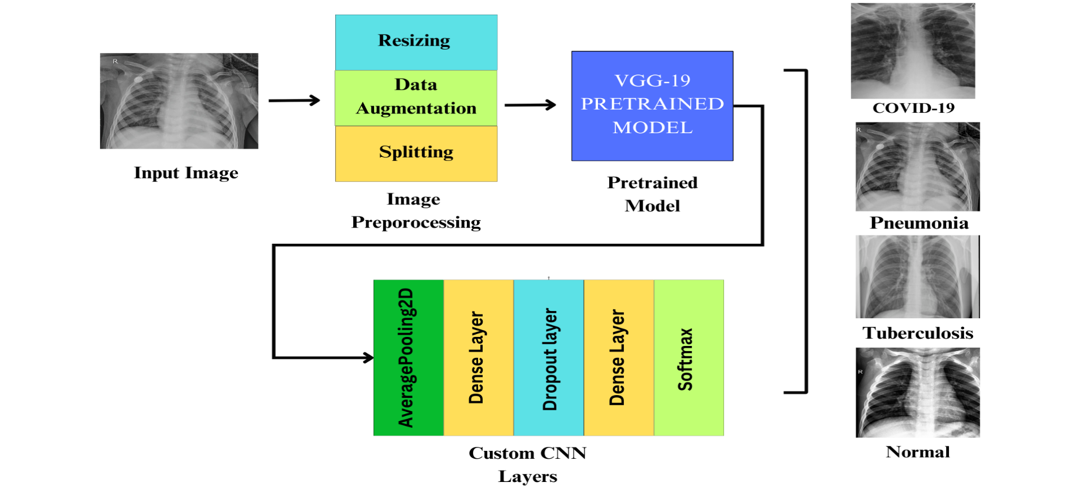
MODEL ARCHITECTURE
Fig :custom Model Architecture

Slide 14
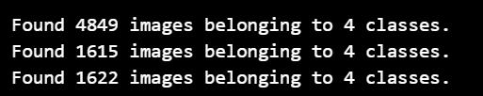
Methodology
1. Dataset preparation
Data Organization:
Divided into train, validation, and test sets.
Preprocessing:
Resized images to 224x224.
Applied normalization (rescale to [0, 1]).
Data Augmentation:
Techniques: Rotation, shifts, shear, zoom, horizontal flips.
Class Balancing:
Computed class weights to address class imbalance.

Slide 15
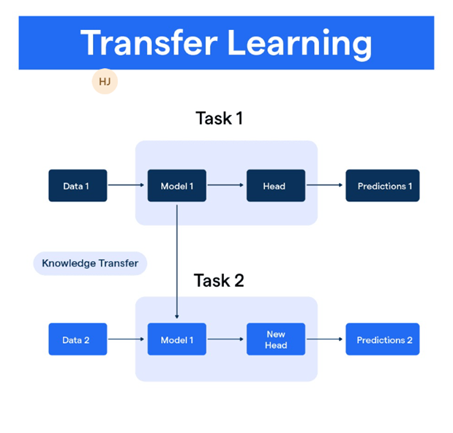
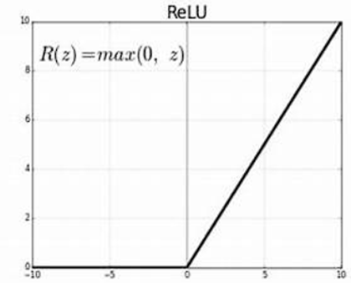
2. Model development
Transfer Learning:
Base Model:
VGG-19 pre-trained on ImageNet.
Layers frozen to retain learned features.
Custom Layers Added:
Global Average Pooling.
Dense layer (256 units, ReLU activation).
Dropout (50%) for regularization.
Softmax output for Multiple classification.
Compilation:
Optimizer: Adam (Learning Rate: 0.0001/1e-4).
Loss Function: Categorical Cross-Entropy.
Fig: Transfer Learning Process
Fig: The RELU activation function

Slide 16
3. Training and Evaluation
Training:
Epochs: 20 with Early Stopping.
Callbacks: Save best model during training.
Used class weights to improve balance.
Evaluation:
Tested on unseen data.
Metrics: Accuracy, Loss, Confusion Matrix,.
Achieved optimal performance by restoring best weights.

Slide 17
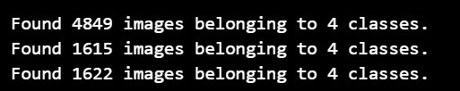
IMPLEMENTATION
1.DATASET PREPARATION
Image distribution across different classes
Test Folder:
Covid: 407 files
Normal: 404 files
Pneumonia: 403 files Tuberculosis: 408 files
Train Folder
Covid: 1218 files
Normal: 1207 files
Pneumonia: 1204 files
Tuberculosis:1220 files
Validation Folder
Covid: 406 files
Normal: 402 files
Pneumonia: 401 files
Tuberculosis: 406 file
1.1Data Organization:
The dataset is Split into train, validation, and test sets.

Slide 18
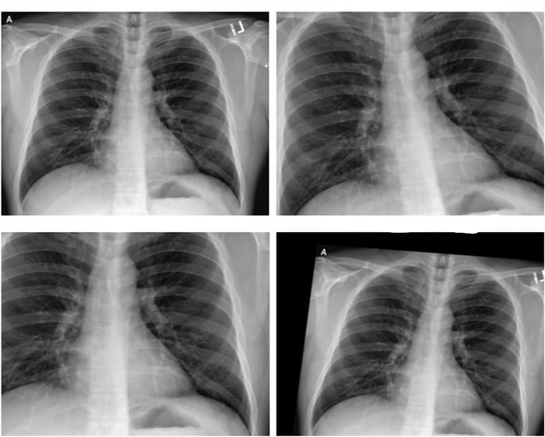
1.2 Preprocessing:
Resize images to 224x224 (VGG19 input size).
Normalize pixel values to [0, 1]. Prevents large values from causing instability in computations, especially in deep networks with multiple layers
1.3 Data Augmentation :
Apply transformations like flipping, rotation, cropping, scaling, and brightness adjustment to increase dataset diversity and improve model generalization.
Fig.1: Samples of Data Augmentation

Slide 19
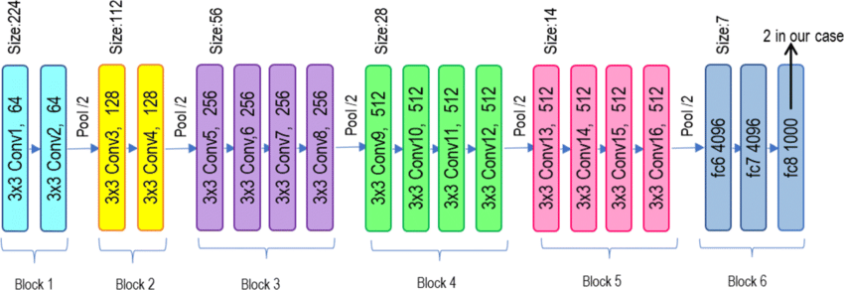
2.MODEL SELECTION
Transfer Learning:​
Base Model: ​
The pre-trained VGG19 architecture is chosen for its proven performance in image classification tasks and its ability to transfer learned features.
Fine-tuning :
The last four layers of VGG19 are unfrozen, allowing fine-tuning to adapt the pre-trained features to the lung disease dataset while preserving the learned weights of earlier layers.
Fig : VGG-19 BaseLine Model

Slide 20
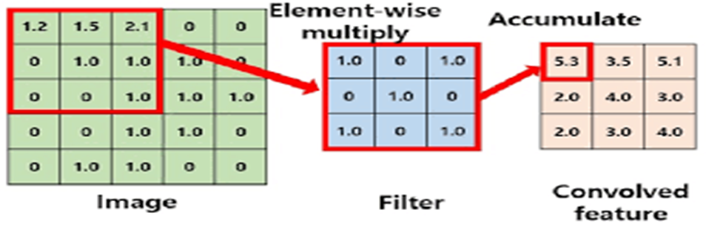
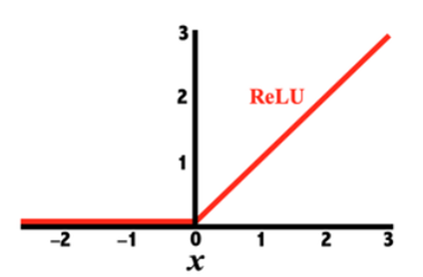
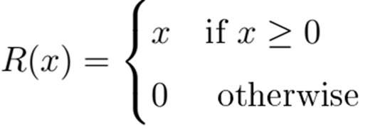
3.CUSTOM MODEL DESIGN
3.1 GlobalAveragePooling2D layer
A GlobalAveragePooling2D layer is added to reduce
the dimensionality of features.
3.2 A fully connected Dense layer
A fully connected Dense layer with 256 units and
ReLU activation is included for feature extraction.
3.3 Dropout layer
A Dropout layer (50%) is used to prevent overfitting.
3.4 final Dense output
A final Dense output layer with a softmax activation is implemented to classify the images into four categories: Covid, Normal, Pneumonia, and Tuberculosis.
Fig :Dimension reduction using filter
Fig :Relu Activation function

Slide 21
4.LOSS FUNCTION
Focal Loss is employed to address class imbalance
by focusing more on hard-to-classify examples,
reducing the effect of dominating easy-to-classify examples.
5. COMPILATION:​
Optimizer:
The Adam optimizer is used with a learning rate of 10^-4
(Learning Rate: 0.0001/1e-4).​
chosen for its adaptive learning capability
and efficient handling of sparse gradients.

Slide 22
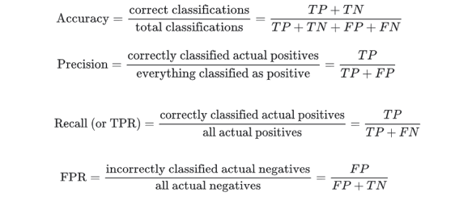
6. MODEL EVALUATION
The trained model is evaluated on the
test dataset to compute metrics like
accuracy, confusion matrix, and a
classification
report.
Confusion Matrix: Visualized with heatmaps to analyze true positive, false positive, and false negative rates for each class.
Training History: Plotted for accuracy and loss over epochs to monitor model convergence.

Slide 23
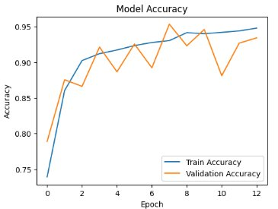
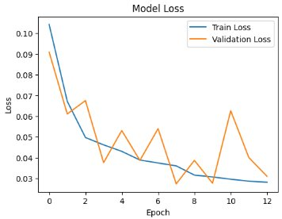
RESULT
Fig :Training and Validation Accuracy​
Fig: Training and Validation Loss​
Both training and validation accuracy increase significantly, reaching about 96.09% & 95.36 respectively by the final epoch ​
​
Both training and validation loss increase significantly, reaching about 0.01 & 0.03 respectively by the final epoch ​
​

Slide 24
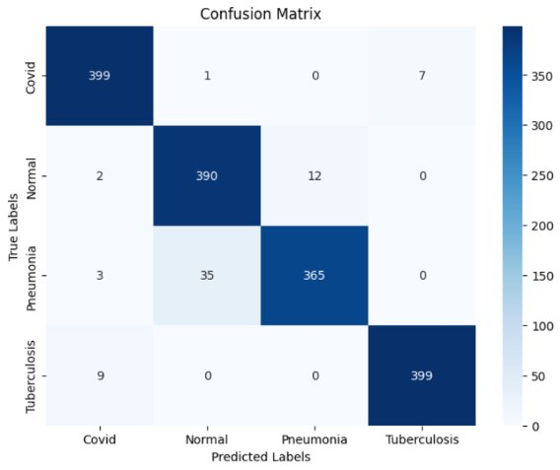
CONFUSION MATRIX​
Covid:​
Correctly classified: 399 out of 409​
Misclassified as:​
Normal: 1 instance​
Tuberculosis: 7 instances​
Pneumonia:​
Correctly classified: 365 out of 403​
Misclassified as:​
Covid: 3 instances​
Normal: 35 instances​
Normal:​
Correctly classified: 390 out of 404​
Misclassified as:​
Covid: 2 instances​
Pneumonia: 12 instances​
​
Tuberculosis:​
Correctly classified: 399 out of 408​
Misclassified as:​
Covid: 9 instances​
​
Fig :Confusion matrix of custom VGG-19 model

Slide 25
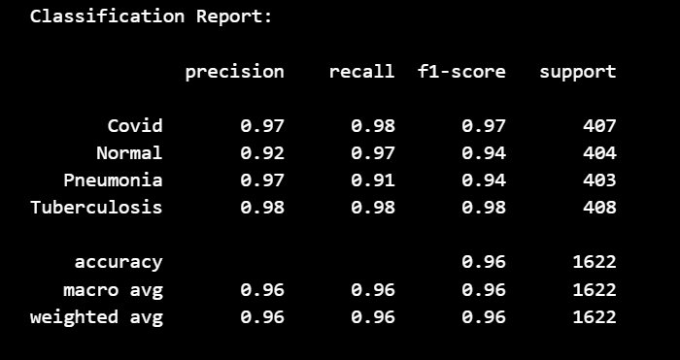
CLASSIFICATION REPORT
A Classification Report summarizes a model's precision, recall, F1-score, and support for each class to evaluate performance.
Test Accuracy: test accuracy achieved (95.75%).​

Slide 26
REFERENCES
[1] Goram Mufarah M. Alshmrani, Qiang Ni, Richard Jiang, Haris Pervaiz, Nada M. Elshennawy, A deep learning architecture for multi-class lung diseases classification using chest X-ray (CXR) images, Alexandria Engineering Journal
[2] Yadav, S.S., Jadhav, S.M. Deep convolutional neural network based
medical image classification for disease diagnosis. Journal of Big Data 6, 113 (2019)
. https://doi.org/10.1186/s40537-019-0276-2
[3] Shivanshu, R. Bisht, K. Mittal and G. P. M. S, "Evaluation of CNN Models for Accurate Classification of COVID-19, Pneumonia, Tuberculosis in Chest X-ray Images," 2023 3rd Asian Conference on Innovation in Technology (ASIANCON), Ravet IN, India, 2023, pp. 1-6, doi: 10.1109/ASIANCON58793.2023.10270526
[4] O. Yadav, K. Passi and C. K. Jain, "Using Deep Learning to Classify X-ray Images of Potential Tuberculosis Patients," 2018 IEEE International Conference on Bioinformatics and Biomedicine (BIBM), Madrid, Spain, 2018, pp. 2368-2375, doi: 10.1109/BIBM.2018.8621525

Slide 27
[5] K. S, R. S. Shudapreyaa, P. Prakash, V. S, V. V and Y. S, "Classification of Lung Diseases Using Transfer Learning with Chest X-Ray Images," 2024 Second International Conference on Emerging Trends in Information Technology and Engineering (ICETITE), Vellore, India, 2024, pp. 1-6, doi: 10.1109/ic-ETITE58242.2024.10493367.
[6] G. M. M. Alshmrani, Q. Ni, R. Jiang, H. Pervaiz, and N. M. Elshennawy, “A deep learning architecture for multi-class lung diseases classification using chest x-ray (cxr) images,” Alexandria Engineering Journal, vol. 64, pp. 923–935, 2023. [Online]. Available: https://www.sciencedirect.com/science/article/pii/S1110016822007104
[7] O. A. Alrusaini, “Covid-19 detection from x-ray images using convoluted neural networks: A literature review,” International Journal of Advanced Computer Science and Applications, vol. 13, no. 3, p. 78 – 88, 2022, cited by: 3; All Open Access, Gold Open Access.
[8] Ouyang X, et al. Dual-sampling attention network for diagnosis of COVID19 from community acquired pneumonia. IEEE Trans Med Imaging. 2020;39(8):2595–605.
[9] M. Hassouna, M. Al-Antary, M. Saleh and N. B. Al Barghuthi, "Applications of Deep Learning in Medical Imaging: A Brief Review," 2023 Advances in Science and Engineering Technology International Conferences (ASET), Dubai, United Arab Emirates, 2023, pp. 1-4, doi: 10.1109/ASET56582.2023.10180645.

Slide 28
[10] M. Irtaza, A. Ali, M. Gulzar and A. Wali, "Multi-Label Classification of Lung Diseases Using Deep Learning," in IEEE Access, vol. 12, pp. 124062-124080, 2024, doi: 10.1109/ACCESS.2024.3454537
[11]M. Berrimi, S. Hamdi, R. Y. Cherif, A. Moussaoui, M. Oussalah and M. Chabane, "COVID-19 detection from Xray and CT scans using transfer learning," 2021 International Conference of Women in Data Science at Taif University (WiDSTaif ), Taif, Saudi Arabia, 2021, pp. 1-6, doi: 10.1109/WiDSTaif52235.2021.9430229
websites
[12]https://en.wikipedia.org/wiki/Neural_network_(machine_learning)
[13]https://www.geeksforgeeks.org/vgg-net-architecture-explained/
Datasets
[14]https://www.kaggle.com/datasets/amrutasalagare/lung-disease-dataset
[15]https://www.kaggle.com/datasets/omkarmanohardalvi/lungs-disease-dataset-4-types

Slide 29


